Slide 1
Tabi: An Efficient Multi-Level Inference System for
Large Language Models
ECCS 2023
硕士研究生：辛威龙
Wang, Yiding et al. “Tabi: An Efficient Multi-Level Inference System for Large Language Models.” Proceedings of the Eighteenth European Conference on Computer Systems (2023): n. pag.

Slide 2
提纲
Background and Motivation
Technology
Experiment
Discussion

Slide 3
提纲
Background and Motivation
Technology
Experiment
Discussion

Slide 4
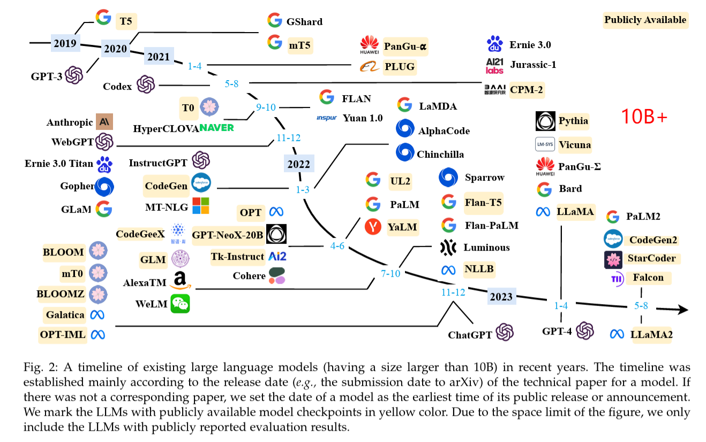
研究背景
Zhao, Wayne Xin et al. “A Survey of Large Language Models.” ArXiv abs/2303.18223 (2023): n. pag.

Slide 5
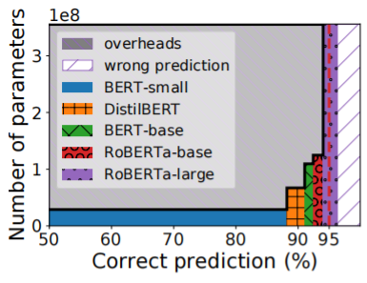
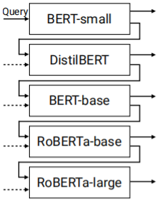
研究背景
当前模型能够正确预测但是其左侧模型无法预测的样本的占比。
计算资源的消耗和模型准确度提升不成正比！
大部分查询可以利用小模型处理。
[1] Roy Schwartz, Jesse Dodge, Noah A Smith, and Oren Etzioni. Green AI. Communications of the ACM, 63(12):54–63, 2020.
[2] Titouan Parcollet and Mirco Ravanelli. The energy and carbon footprint of training end-to-end speech recognizers. 2021.

Slide 6
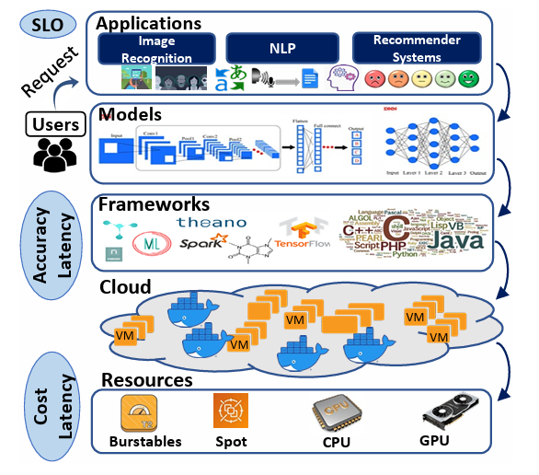
研究背景
任务准确度
最大处理延迟
INFaaS
Cocktail
模型冗余
资源浪费
Model-less Inference
Gunasekaran, Jashwant Raj et al. “Cocktail: A Multidimensional Optimization for Model Serving in Cloud.” Symposium on Networked Systems Design and Implementation (2022).

Slide 7
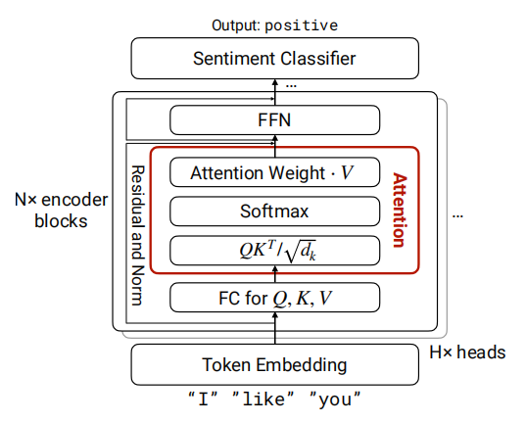

研究背景
维度为$d_{k}$的向量
Attention注意力机制

Slide 8
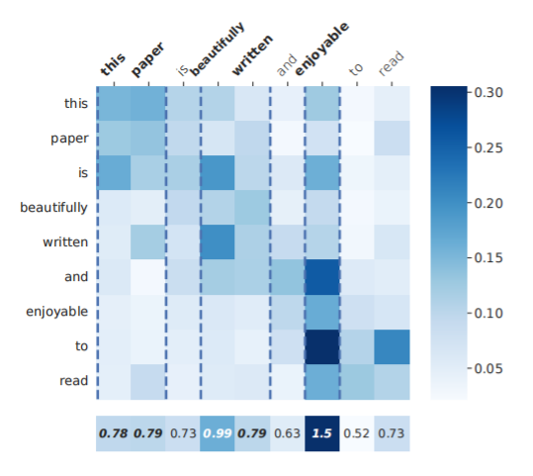
研究背景
importance vector

Slide 9
研究动机
多级模型级联
基于注意力的token裁剪

Slide 10
提纲
Background and Motivation
Technology
Experiment
Discussion

Slide 11
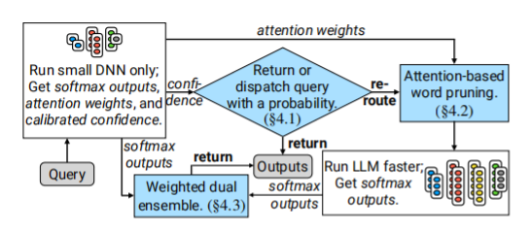
技术实现
Overview

Slide 12


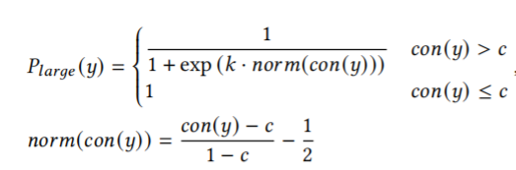
技术实现
over-confident
temperature scaling
Chuan Guo, Geoff Pleiss, Yu Sun, and Kilian Q Weinberger. On calibration of modern neural networks. In International Conference on Machine Learning, pages 1321–1330. PMLR, 2017.

Slide 13
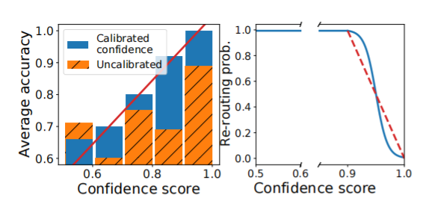
技术实现

Slide 14

技术实现

Slide 15
提纲
Background and Motivation
Technology
Experiment
Discussion

Slide 16
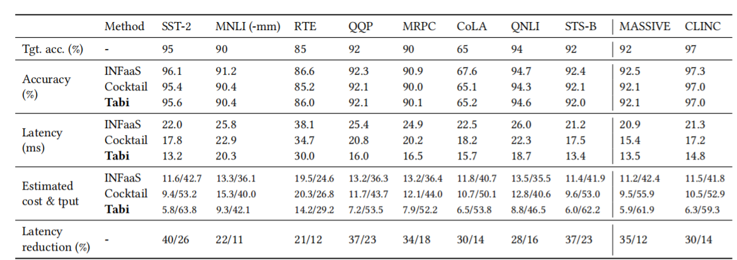
实验
Inference latency: 21%-40% , 11%-26%
Throughout: 16%-49%, 5%-20%

Slide 17
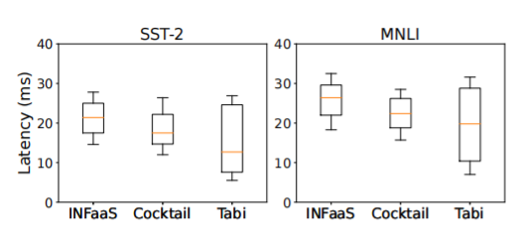
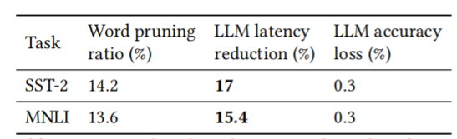
实验
99%
75%
50%
25%
1%

Slide 18
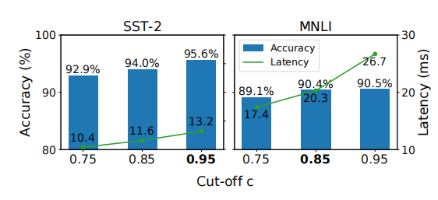
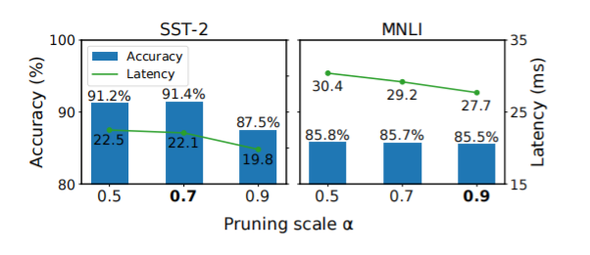
实验

Slide 19
提纲
Background and Motivation
Technology
Experiment
Discussion

Slide 20
总结与讨论
CascadeBERT
还是尽可能对模型架构、推理执行过程进行优化

Slide 21


